Slide 1

Vectors: Addition, Multiplication
Chapter 3: VECTORS
RIMSHA Bashir Awan
FAST-National University of Computer and Emerging Sciences

Slide 2
Outline
Vectors and their representation
Adding and Subtracting Vectors Graphically
Vector Components
Adding vectors by components
Unit Vectors
Vector Multiplication
Dot Product of Vectors
Cross product of Vectors

Slide 3
Vectors
Vector a quantity that has both magnitude (size) and direction
Examples: displacement, velocity, acceleration
Scalar
a quantity that has no direction associated with it, only a magnitude
Examples: distance, speed, time, mass
Scalar

Slide 4
Vectors are represented by arrows.
The length of the arrow represents the magnitude (size) of the vector.
And, the arrow points in the appropriate direction.
20 m/s
50 m/s
NW
East

Slide 5
Adding vectors graphically
+
Without changing the length or the direction of any vector, slide the tail of the second vector to the tip of the first vector.
2. Draw another vector, called the RESULTANT, which begins at the tail of the first vector and points to the tip of the last vector.>

Slide 6

Subtracting vectors graphically
First, reverse the direction of the vector you are subtracting. Then, without changing the length or the direction of any vector, slide the tail of the second vector to the tip of the first vector.
2. Draw another vector, called the RESULTANT, which begins at the tail of the first vector and points to the tip of the last vector.

Slide 7
Adding co-linear vectors (along the same line)
A = 8 m
B = 4 m
A + B = R = 12 m
C = 10 m/s
D = - 3 m/s
C + D = 10 + (-3) = R = 7 m/s

Slide 8
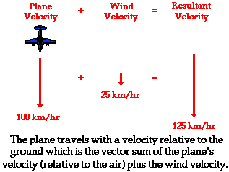
Airplane Tailwind

Slide 9
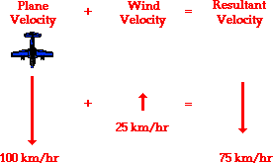
Airplane Headwind

Slide 10
Adding perpendicular vectors
11.67 m
6 m
10 m
How could you find out the length of the RESULTANT?
Since the vectors form a right triangle, use the PYTHAGOREAN THEOREM
A² + B² = C²

Slide 11
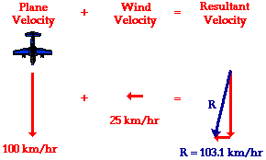

Slide 12
Vector COMPONENTS
Each vector can be described in terms of its x and y components.
Y (vertical)
component
X (horizontal) component
If you know the lengths of the x and y components, you can calculate the length of the vector using the Pythagorean.

Slide 13
Drawing the x and y components of a vector is called “resolving a vector into its components”
Make a coordinate system and slide the tail of the vector to the origin.
Draw a line from the arrow tip to the x-axis.
The components may be negative or positive or zero.
X component
Y component

Slide 14
Calculating the components How to find the length of the components if you know the magnitude and direction of the vector.
Sin θ =per / hyp
Cos θ = base / hyp
Tan θ = per / base
= 12 m/s
A
A_{y}
= A sin θ
= 12 sin 35 = 6.88 m/s
θ
= 35 degrees
A_{x}
= A cos θ
= 12 cos 35 = 9.83 m/s

Slide 15
Are these components positive or negative?

Slide 16
V = 22 m/s
What is v_{x}?
V_{x} = - v cos θ˚
V_{x} = -22 cos 50˚
V_{x} = - 14.14 m/s
What is v_{y}?
V_{y} = v sin θ˚
V_{y} = 22 sin 50˚
V_{y} = 16.85 m/s
θ = 50˚

Slide 17
Finding the angle
Suppose a displacement vector has an x-component of 5 m and a y-component of - 8 m. What angle does this vector make with the x-axis?
θ = ?
We are given the side adjacent to the angle and the side opposite the angle.
Which trig function could be used?
Tangent θ = perpendicular ÷ Base
Therefore the angle θ = tan ⁻¹ (perpendicular ÷ Base )
θ = 32 degrees below the positive x-axis

Slide 18

Adding Vectors by components
A = 18, θ = 20 degrees
B = 15, β = 40 degrees
B
A
β
θ
Slide each vector to the origin.
Resolve each vector into its x and y components
The sum of all x components is the x component of the RESULTANT.
The sum of all y components is the y component of the RESULTANT.
Using the components, draw the RESULTANT.
Use Pythagorean to find the magnitude of the RESULTANT.
Use inverse tan to determine the angle with the x-axis.
α
x
y
A
18 cos 20
18 sin 20
B
-15 cos 140
15 sin 140
R
5.42
15.8
α = tan⁻¹(15.8 / 5.42) = 71.1 degrees above the positive x-axis

Slide 19
Unit Vectors
A unit vector is a vector that has a magnitude of exactly 1 unit. Depending on the application, the unit might be meters, or meters per second. The unit vectors are in the positive x, y, and z axes and are labeled

Slide 20
Examples of Unit Vectors
Example 1: A position vector (or r = 3i + 2j )
is one whose x-component is 3 units and y-component is 2 units (SI units: meters).
Example 2: A velocity vector
The velocity has an x-component of 3t units (it varies with time) and a y-component of -4 units (it is constant). (SI units: m/s)

Slide 21
Working with unit vectors
Suppose the position, in meters, of an object was given by r = 3t³i + (-2t² - 4t)j
What is v?
Take the derivative of r!
What is a?
Take the derivative of v!
What is the magnitude and direction of v at t = 2 seconds?
Plug in t = 2, pythagorize i and j, then use arc tan (tan ⁻¹)to find the angle!

Slide 22
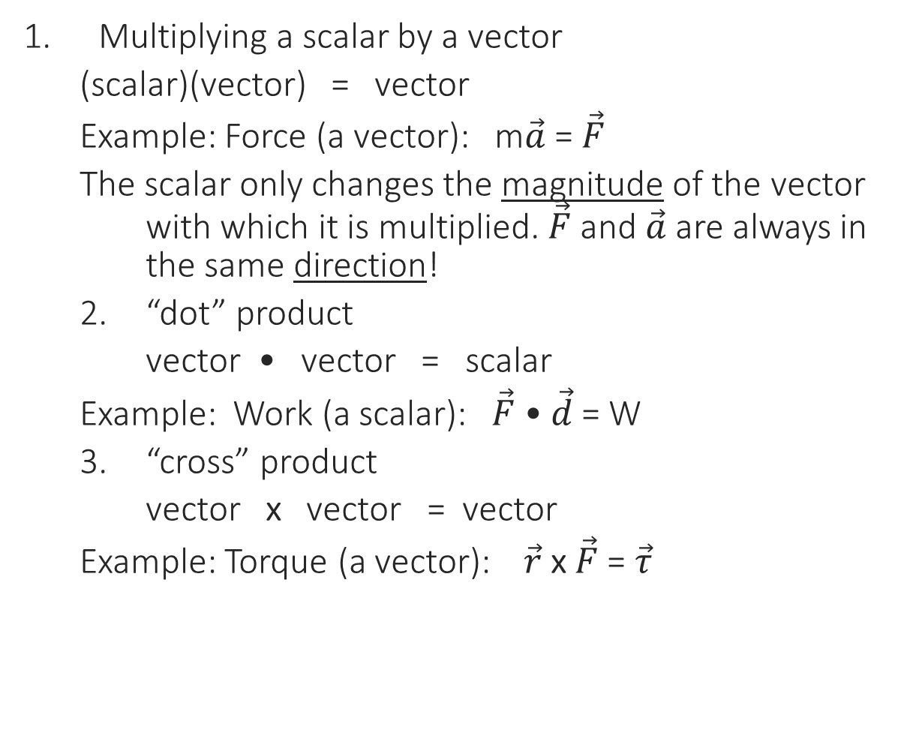
Vector Multiplication
Multiplying a scalar by a vector
(scalar)(vector) = vector
Example: Force (a vector): m$\vec{a}$ = $\vec{F}$
The scalar only changes the magnitude of the vector with which it is multiplied. $\vec{F}$ and $\vec{a}$are always in the same direction!
“dot” product
vector • vector = scalar
Example: Work (a scalar): $\vec{F}$ • $\vec{d}$ = W
“cross” product
vector x vector = vector
Example: Torque (a vector): $\vec{r}$ x $\vec{F}$ = $\vec{τ}$

Slide 23
Dot products:
A • B = AB cos θ (a scalar with magnitude only, no direction)
(6)(4) cos 100˚
− 4.17
Cross products:
Cross products yield vectors with both magnitude and direction
Magnitude of Cross products:
A x B = AB sin θ
(6)(4) sin 100 ˚
= 23.64
A= 6
θ = 100 ˚
B= 4

Slide 24
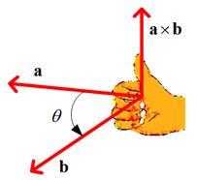
Use the “right-hand rule” to determine the direction of the resultant vector.

Slide 25
Multiplication using unit vector notation…. Direction of cross products for unit vectors
i x j = k
j x k = i
k x i = j
j x i = -k
k x j = -i
i x k = -j
+
ijkijk
-

Slide 26
For DOT products, only co-linear components yield a non-zero answer.
3i • 4i = 12 (NOT i - dot product yield scalars)
3i x 4i = 0
Why? (3)(4) cos 0˚ = 12 and (3)(4) sin 0˚ = 0
For CROSS vectors, only perpendicular components yield a non-zero answer.
3i • 4j = 0
3i x 4j = 12k (k because cross products yield vectors)
Why? (3)(4) cos 90˚ = 0 (3)(4) sin 90˚ = 12
The direction is along the k-axis

